Slide 1
Addressing Modes

Slide 2
Operand, Operator and Opcode
Operands are the objects that are manipulated and operators are the symbols that represent specific actions.
For example, in the expression x + 5, x and 5 are operands and + is an operator.
Opcode is an instruction that tells processor what to do with the variable or data written besides it.
For Example: ADD R1,R2
ADD is the Opcode and R1 and R2 are the Operand.

Slide 3
Addressing Modes – What is…
The term addressing modes refers to the way in which the operand of an instruction is specified.
The addressing mode specifies a rule for interpreting or modifying the address field of the instruction before the operand is actually executed.
An addressing mode specifies how to calculate the effective memory address of an operand by using information held in registers and/or constants contained within a machine instruction

Slide 4
Format
The control unit is designed to go through an instruction cycle that is divided into three major phases:
Fetch the instruction
Decode the instruction
Execute the instruction
There is one register called Program Counter (PC) that keeps track of the instructions in the program stored in memory.
An example of an instruction format with a distinct addressing mode field is shown in following figure:

Slide 5
Addressing Modes – Types
Immediate
Direct
Indirect
Register
Register Indirect
Displacement (Indexed)
Stack
Notes:
2

Slide 6
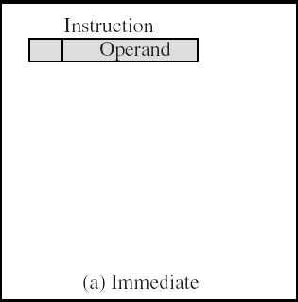
Immediate Addressing
Operand is part of instruction
Operand = address field
e.g. - ADD AX, 5h
- LDA #5
Add 5 to contents of accumulator
5 is operand
No memory reference to fetch data
Fast
Limited range
Notes:
3

Slide 7
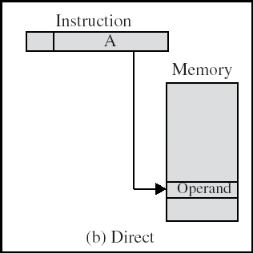
Direct Addressing
Address field contains address of operand
Effective address EA = address field (A)
ADD AX, value
Value DB 05h
Add contents of cell value to accumulator AX
Look in memory at address value for operand
Single memory reference to access data
No additional calculations to work out effective address
Limited address space
Notes:
5

Slide 8
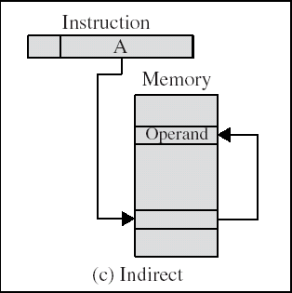
Indirect Addressing
Memory cell pointed to by address field contains the address of (pointer to) the operand
EA =(A)
Look in A, find address (A) and look there for operand
e.g. ADD AX, (A)
Add contents of cell pointed to by contents of A to accumulator
Notes:
7

Slide 9
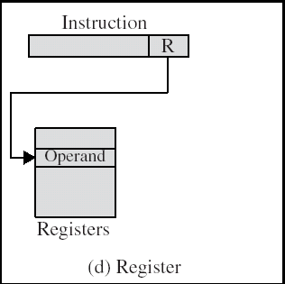
Register Addressing
Operand is held in register named in address filed
EA = R
Limited number of registers
Very small address field needed
Shorter instructions
Faster instruction fetch
MOV AX, BX
ADD AX, BX
Notes:
10

Slide 10
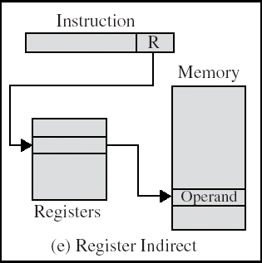
Register Indirect Addressing
Indirect addressing
EA = (R)
Operand is in memory cell pointed to by contents of register R
Large address space (2^{n})
One fewer memory access than indirect addressing
Notes:
13

Slide 11
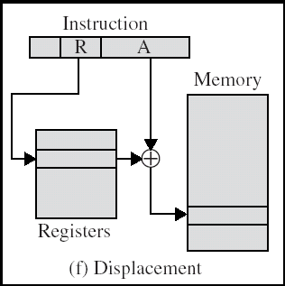
Displacement Addressing
EA = A + (R)
Effective address=start address + displacement
Effective address=Offset + (Segment Register)
Use direct and register indirect
Address field hold two values
A = base value
R = register that holds displacement
or vice versa
Notes:
15

Slide 12
Relative Addressing (PC-Relative)
A version of displacement addressing
R = Program counter, PC
EA = A + (PC)
i.e. get operand from A cells from current location pointed to by PC
c.f locality of reference & cache usage
Notes:
17

Slide 13
Base-Register Addressing
A holds displacement
EA = (CS) + A
R holds pointer to base address
R may be explicit or implicit
Notes:
18

Slide 14
Indexed Addressing
A = base
R = displacement
EA = A + (R)
Good for accessing arrays
EA = A + (R)
R++
Notes:
19

Slide 15
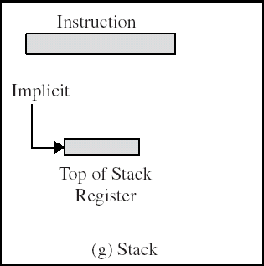
Stack Addressing
Operand is (implicitly) on top of stack
e.g.
ADD Pop top two items from stack and add and push
Notes:
21

Slide 16
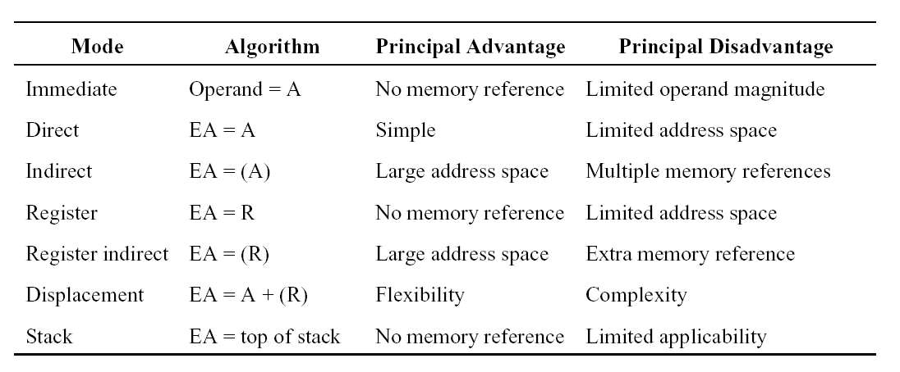
Finally…

Slide 17
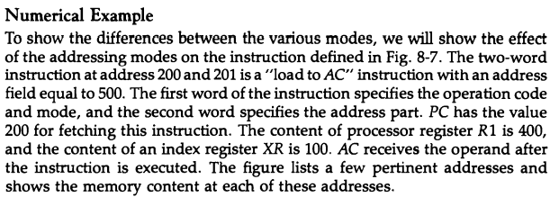

Slide 19
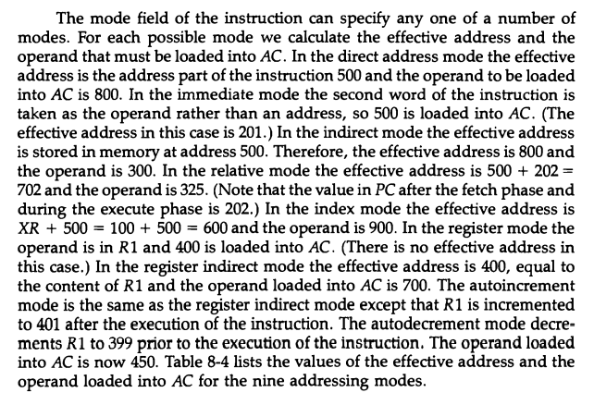

Slide 20
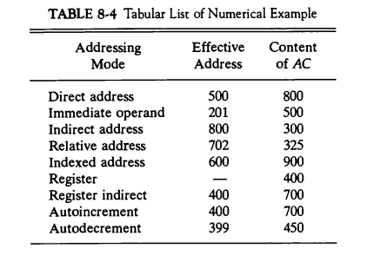

Slide 21
Address Instructions

